Slide 1

The Freedom of Access Act
For Legislators
Attorney General Aaron Frey
Public Access Ombudsman Brenda Kielty
132nd Maine Legislature
December 3, 2024

Slide 2
The Freedom of Access Act
“FOAA”
1 M.R.S. § 400, et seq.
Why are you here?
  Legislators are public record “creators” with duties to manage, retain and produce public records. Your public records are subject to disclosure under FOAA.
  Legislature, committees and subcommittees governed by FOAA public proceedings requirements.
Purpose today?
  Overview of the Freedom of Access Act, required training and resources for questions.
  See Nik Rende for IT aspects of legislative communications, such as email.
  See Suzanne Gresser contact point/public access officer for the Legislature.

Slide 3
FOAA Training Requirements
Who?
  Elected state and local officials
  Public access officers
What?
  Public records and proceedings rules
  Procedures compliance
  Penalties and consequences of noncompliance
When?
  Within 120 days of oath of office
How?
  Complete this session; certificate of completion

Slide 4

Underlying Purpose of FOAA?
FOAA embodies the principle that “public proceedings exist to aid in the conduct of the people’s business” and was enacted with the express intent that actions by a body subject to FOAA “be taken openly” and that “their deliberations be conducted openly.”
The Maine Supreme Judicial Court has elaborated the purpose of FOAA by reference to the intent of the federal FOIA “to ensure an informed citizenry, vital to the functioning of a democratic society, needed to check against corruption and to hold the governors accountable to the governed.”

Slide 5

Liberal Construction
“This subchapter shall be liberally construed and applied to promote its underlying purposes and policies…”
1 M.R.S. §401

Slide 6
FOAA FOIA
Maine’s Freedom of Access Act
U.S. Freedom of Information Act
First enacted in 1959, then replaced in 1976 with current structure
Covers public records and proceedings
Applies to executive and legislative officials and bodies
Became law in 1967, then amended in 1974 to protect citizens’ rights to information about themselves
Covers only records
Applies only to federal executive agencies and not to Congress

Slide 7
What Does the Law Cover?
Public Records
Public Proceedings
Written, graphic or electronic
Possession or custody of an agency or official of State or political subdivisions
Received, prepared or containing information related to transaction of public business
Transaction of any function affecting citizens
By one of the covered bodies
Deliberations and decisions

Slide 8
Rights of the Public: Records
To receive an acknowledgement within five working days
To be told within five working days if the request will be denied, in whole or in part
To receive an estimate of costs in a reasonable amount of time
To inspect and copy records within a reasonable time after making a request
BUT agency/official is not required to create records or arrange information in a specific form
To appeal a denial of records to Superior Court

Slide 9
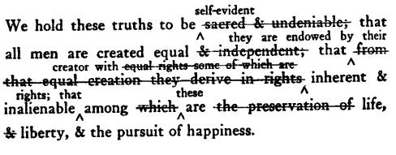
True or False?
Your bill drafts and proposed committee amendments are not public records.

Slide 10
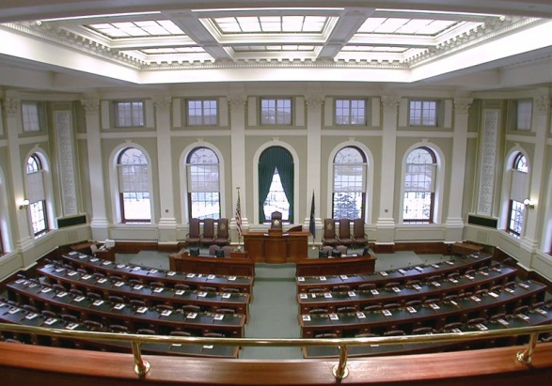
TRUE, legislative papers and reports are not public records until signed and publicly distributed
Working papers, drafts, records, and memoranda used to prepare proposed legislative papers or reports are not public records until the end of the legislative session in which the papers or reports are prepared or considered or to which they are carried over

Slide 11

True or False?
Documents on a legislator’s personal laptop, tablet or smartphone are not public records.

Slide 12

TRUE, they are private if they are personal
FALSE, they are public records if they concern the conduct of your business as a legislator
KEY: Records of your business as a legislator are public regardless of their location

Slide 13

True or False?
Communications from a constituent to a legislator are public records.

Slide 14
TRUE, except personal information in the communication concerning:
  Medical information of any kind
  Credit or financial information
  Personal history, general character or conduct of the constituent or a family member
  Complaints, charges of misconduct or disciplinary action
  Social Security number
  Information that would be confidential if in the possession of another public agency or official

Slide 15

Should a legislator’s email include a disclaimer about privacy?
YES, even though some information is protected by the exception. Constituents should be aware that the contents of emails they send to their legislators could be released as a public document under FOAA.
“Please be advised that anything sent to me in my capacity as a legislator may become a matter of public record, per the Maine Freedom of Access Act www.maine.gov/foaa/, which means that other people can ask to read these messages.”
IT can help set this up for you.

Slide 16
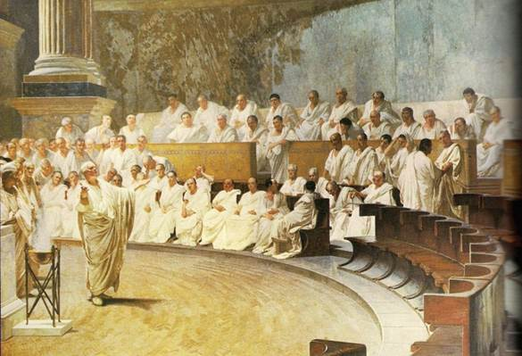
Meetings Open to the Public
“…all public proceedings must be open to the public and any person must be permitted to attend a public proceeding.”
1 M.R.S. §403

Slide 17
Meetings: What governmental bodies are subject to FOAA?
The Legislature, its committees and subcommittees (three or more members appointed by the committee to do its business)
Boards or commissions of state agencies, county or municipal agencies, school or other governmental districts
Advisory organizations created by statute, resolve or executive order
KEY: Agencies where multi-member bodies make the decisions (e.g., Leg. Council), but not single agency heads (e.g., the Speaker or President)

Slide 18
Rights of Public: Meetings
To attend any public proceeding and get minutes
BUT not to speak unless the body or law permits it
To record or broadcast
BUT not in a way that interferes with the meeting
To get advance notice of when and where
EVEN emergency meetings, if practicable
To challenge in Superior Court the legality of final actions taken in executive session
AND have the court declare the action null and void

Slide 19
Remote Meeting Access: Requirements
Remote or hybrid public meetings are allowed if:
  The body has adopted a written policy after notice and hearing;
  The public must have a meaningful opportunity to attend remotely when members attend remotely;
  Reasonable accommodations when necessary for access to individuals with disabilities;
  If there is public comment, there must be an effective means of communication between members of body and the public;
  Notice includes methods by which public may attend. Identify a location for the public to attend in person, unless the meeting is fully remote;
  All votes taken are by roll call vote and can be seen and heard if using video or heard if only audio, by other members and the public;
  Written documents and materials considered by body are available to the public to same extent as when attend in person, as long as no additional costs.

Slide 20
Remote Meeting Access: Adopting a Policy
A body can hold a remote hearing on a proposed written policy if the chair determines that an emergency or urgent issue prevents an in-person meeting;
If 2/3 of the members vote in support of the chair’s determination, and after an opportunity for hearing, the members may vote on adoption;
Notice of the hearing should include how the public can participate and the proposed policy or how to obtain a copy in advance of the meeting.

Slide 21
Remote Meeting Access Evolution
PL 2021, c. 666 repealed the requirement that members of a public body attend meetings in person unless “not practicable.”
This change expanded the possible use of remote participation by individual members of a body.
The body may limit public attendance to remote methods if there is an emergency or urgent situation that requires the entire body to meet remotely.

Slide 22
Remote Meetings for Legislative Committees
The remote participation provisions in FOAA do not apply to the Legislature or public bodies which have specific statutory provisions.
Proceedings of the Legislature and its committees governed by Joint Rules.
No Rule yet for 132nd.

Slide 23
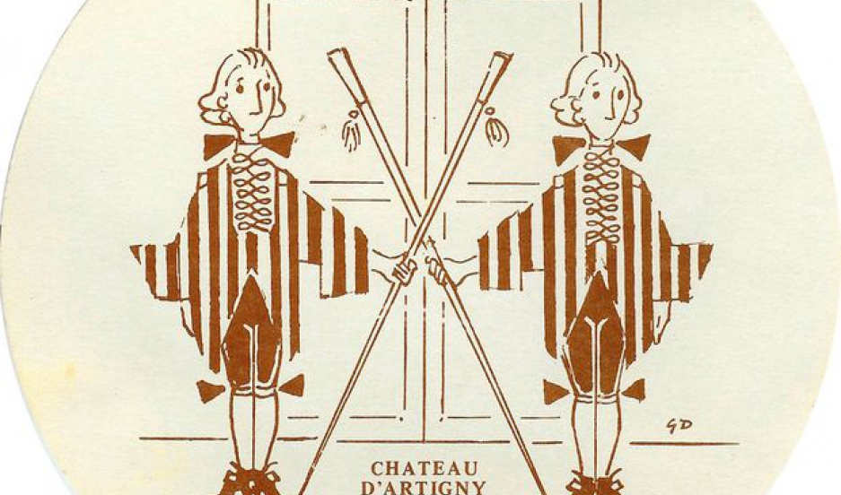
True or False?
A legislative committee can meet privately to discuss sensitive issues before a public committee session begins.

Slide 24
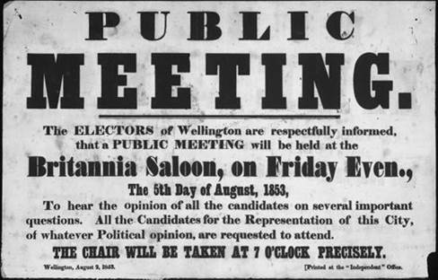
FALSE, committees and subcommittees must conduct business in public. A legislative subcommittee is 3 or more legislators from a committee appointed for the purpose of conducting committee business on behalf of the committee.
Must give notice of meeting time and place.
Party caucuses are likely outside scope of the law. What if decisions are being made in caucus? Does this circumvent the purpose of open deliberations and actions?

Slide 25

True or False?
The law doesn’t apply if fewer than three members of a committee meet to do business.
What if a committee asks two members to meet with interested parties to negotiate a compromise on a bill and the public is excluded from that meeting?

Slide 26

TRUE, not covered as a subcommittee but a court might conclude the meeting should have been public if decisions were made.
KEY: It isn’t the number of participants but the purpose of the meeting that is determinative; communicating with other members outside of the public meeting is permitted as long as those communications are not used to defeat the purpose of the law.

Slide 27

Exceptions: Executive Sessions
Strictly limited grounds
  Confidential by statute
  Certain employment related matters
  Consideration of the condition,
  acquisition or use of property
  Labor contracts
  Consultations with legal counsel
  School board student suspensions or expulsions
Procedural Safeguards
  Precise description of business
  Cite authority for the executive session
  3/5 vote
  Cannot take action or vote in executive session

Slide 28

Penalties
A willful violation of FOAA is subject to a civil penalty of not more than $500 for the first violation, not more than $1,000 for the second violation not more than 4 years after the previous adjudication and not more than $2,000 for the third violation not more than 4 years after the previous adjudication.
Same agency but can involve different officers or employees.
It is a Class D crime to intentionally remove, alter or destroy state public records.

Slide 29

Attorneys’ Fees
Reasonable attorneys’ fees can be awarded to a plaintiff who substantially prevails if a public agency or official acted in bad faith:
In denying access to public records, or
In taking final action in an executive session

Slide 30
Right to Know Advisory Committee
Provide guidance in ensuring access to public meetings and public records
Review exceptions to public access on a schedule and as needed in specific cases
Support to Judiciary Committee on review of new exceptions to public access

Slide 31
Resources
Maine Freedom of Access Website:
http://www.maine.gov/foaa
Right to Know Advisory Committee Website:
https://legislature.maine.gov/right-to-know-advisory-committee
State agency public access officers contact list:
http://maine.gov/foaa/contactlist/index.htm
Maine Public Access Ombudsman:
  Brenda Kielty
  Office of the Attorney General
  brenda.kielty@maine.gov
  626-8577

